Slide 1
Monte Carlo Methods
Some example applications in C++

Slide 2
Introduction
http://en.wikipedia.org/wiki/Monte_Carlo_method
“Monte Carlo methods (or Monte Carlo experiments) are a class of computational algorithms that rely on repeated random sampling to compute their results.
Monte Carlo methods are often used in simulating physical and mathematical systems.”
To illustrate the implementation of this kind of algorithm in C++ we will look at just a few basic applications where the MC method can help us solve problems in:
Maxima, Minima and Optimization
Probability and Counting Experiments

Slide 3
The rand() function
Key to the Monte Carlo method is the generation of sequences of random numbers.
C++ has a built-in function for this:
rand() returns a number randomly selected
in the range 0 to RAND_MAX
Note that the sequence of number is not actually random, an algorithm is used to generate the numbers in a chaotic manner with a large period(the number of values returned before the sequence repeats).
Related function:
srand(n) sets the seed of the random number
generator to n (to allow us to obtain
different sequences of random numbers).

Slide 4
Generating and processing rand() values
Monte Carlo methods use large sets of random numbers,
so we generally place the rand() function inside a large loop.
For example:
Note that the cstdlib
header is required.
#include <iostream>
#include <cstdlib>
using namespace std;
int main() {
int n = 100000;
cout << RAND_MAX << endl;
for (int i=0; i<n; i++) {
int k = rand();
cout << k << endl;
}
}
2147483647
1804289383
846930886
1681692777
1714636915
1957747793
424238335
719885386
1649760492
.
.

Slide 5
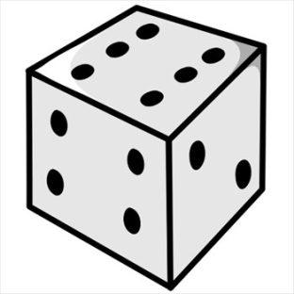
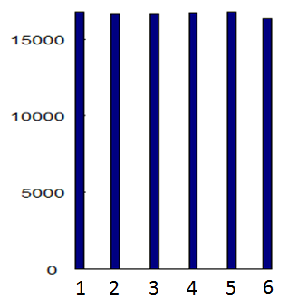
Obtaining a discrete uniform distribution
For example if we want to simulate
the throw of a die having six discrete
random outcomes, all with equal probability:
int k = 1 + rand() % 6;
Modulo 6 returns 0 ≤ k ≤ 5
+1 gives 1 ≤ k ≤ 6
k
Store in integer k
Histogram

Slide 6
C++ code
Roll ten dice:
Output
Seed = 12345679
#include <iostream>
#include <cstdlib>
using namespace std;
int main() {
srand(12345678);
for (int i=0; i<10; i++) {
int d = 1 + rand() % 6;
cout << d << endl;
}
}
2
6
4
6
3
1
4
2
6
6
1
5
6
1
6
6
5
6
5
1
4
6
3
2
4
1
1
3
5
2
Seed = 12345680
Seed = 12345678

Slide 7
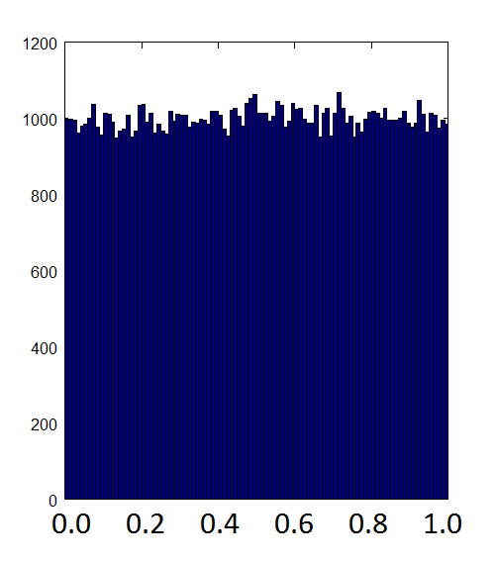
Obtaining a continuous uniform distribution
Often we require floating-point random values:
double r = rand()/(1.0+RAND_MAX);
Cast to a double value slightly
larger than RAND_MAX
Returns 0.0 ≤ r < 1.0
Example sequence:
0.24308 0.62229
0.77675 0.46182
0.24792 0.95476
0.74463 0.52671
Histogram of r
r = 1.0 would be an overflow in the histogram

Slide 8
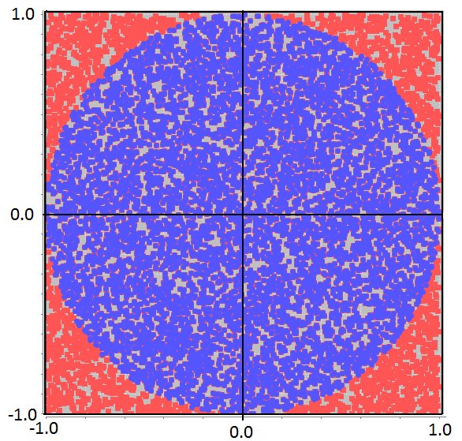
Example
Populate a square with n randomly-place points
[the blue and red points]
Count the number of points m that lie inside the circle [the blue points]
The ratio 4m/n is then an approximation to the area of the circle (the area of the square being 4 units²)
and therefore an approximation to π.
-1.0 ≤ x < +1.0
-1.0 ≤ y < +1.0

Slide 9
C++ code
Output for
n = 10⁵
#include <iostream>
#include <cstdlib>
using namespace std;
int main() {
int n = 100000;
int m = 0;
for (int i=0; i<n; i++) {
double x = 2.0*rand()/(RAND_MAX+1.0) -1.0;
double y = 2.0*rand()/(RAND_MAX+1.0) -1.0;
if ( x*x+y*y < 1.0 ) m++;
}
cout << 4.0*m/n << endl;
}
-1.0 ≤ x < +1.0
-1.0 ≤ y < +1.0
3.14376
Convergence
n
10²
10⁴
10⁶
10⁸
π
2.84
3.1288
3.14307
3.14162
3.14159
A factor of 100 increase in n yields a factor of 10 improvement in accuracy
This method works! but requires very large statistics to obtain good accuracy.

Slide 10
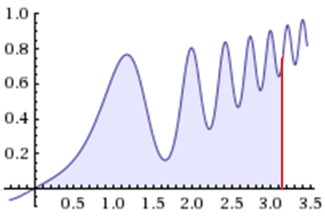
Maxima/Minima
Aim
We wish find the maximum or minimum of a function f(x).
For example, find the maximum of the following function in the
range 0 ≤ x < π
How can we do this with
random numbers?
Solution
Generate a large number of
random values x in the range
0 ≤ x < π, evaluate f(x) at each
point, record the position of the
largest value.
f(x)
x
0
π

Slide 11

C++ code
#include <iostream>
#include <cmath>
#include <cstdlib>
using namespace std;
int main() {
int n = 100000;
double xmax = 0., fmax = 0.;
for (int i=0; i<n; i++) {
double x = M_PI * rand()/(RAND_MAX+1.0);
double f = x*pow((0.5+exp(-x)*sin(x*x*x)),2);
if ( f > fmax ) {
fmax = f;
xmax = x;
}
}
cout << "f=" << fmax << endl;
cout << "x=" << xmax << endl;
}
Output for
n = 10⁵
0 ≤ x < π
f=0.90536
x=2.99013
time = 12 ms
Convergence
n
10¹
10²
10³
10⁴
10⁵
f=0.837919
f=0.905246
f=0.904914
f=0.905358
f=0.905360
http://www.wolframalpha.com/

Slide 12
Optimization
Aim
Similar to the idea of obtaining the maximum or minimum of a function, we sometimes wish to optimize a system;
i.e. maximise or minimize a target quantity.
Example
We have 50 meters of fencing and wish to construct a fenced rectangular area, sides a and b with the target of maximizing the area A = a b enclosed by the fence.
b
a
A = a b
a
b
2a + 2b = 50 ⇒ b = 25 – a with 0 < a < 25

Slide 13
C++ code
#include <iostream>
#include <cstdlib>
using namespace std;
int main() {
int n = 1e5;
double max_area = 0., max_a = 0.;
for (int i=0; i<n; i++) {
double a = 25.0 * rand()/(RAND_MAX+1.0);
double b = 25.0 - a;
double area = a*b;
if ( area > max_area ) {
max_area = area;
max_a = a;
}
}
cout << max_a << endl;
}
Output for
n = 10⁵
b = 25 – a
with 0 < a < 25
12.4998
time = 1 ms
Convergence
n
10¹
10²
10³
10⁴
10⁵
10⁶
13.8492
12.3396
12.4631
12.5005
12.4998
12.5000
12.5
12.5

Slide 14
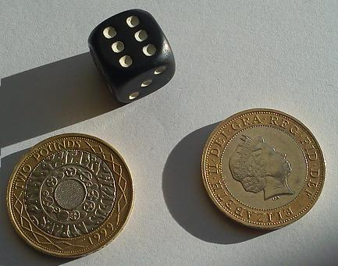
Probability and Counting Experiments
Aim
Many physical systems are governed by random processes.
Common examples are the tossing of a coin and the throw of dice. Monte Carlo methods allow us to simulate such systems and calculate outcomes in terms of probabilities.
“6”
For example, two coins and one die are thrown. What is the probability of obtaining a “Tail”, “Head” and a “6” in any order: P(“T”,“H”,“6”) ?
Head “H”
Solution; throw n times and count the number of times m that we get the outcome.
Then m / n → P(T,H,6) as n → ∞
Tail “T”
Experimental definition of probability

Slide 15
C++ code
#include <iostream>
#include <cstdlib>
using namespace std;
int main() {
int n = 1e5;
int m = 0;
for (int i=0; i<n; i++) {
int die = rand() % 6 + 1;
int coin1 = rand() % 2;
int coin2 = rand() % 2;
if ( die==6 && (coin1 != coin2) ) m++;
}
cout << "1/" << 1/(double(m)/n) << endl;
}
Output for
n = 10⁵
1/11.925
Convergence
n
10²
10³
10⁴
10⁵
10⁶
10⁷
10⁸
10⁹
1/7.6923
1/10.870
1/11.933
1/11.925
1/11.997
1/12.017
1/11.996
1/12.001
“T” “H” or “H” “T”
This method works! but requires very large statistics to obtain good accuracy.

Slide 16
Example
Bacteria are grown in culture dishes in a laboratory.
Experience tells us that on average in this lab 20% of the dishes become contaminated by unwanted bacteria (thus spoiling the culture).
Question:
If the lab is growing bacteria in ten dishes, what is the probability that more then half of the dishes will become contaminated?
Solution:
We have ten dishes, P(“contamination of each dish”) = 0.2
Use a Monte Carlo experiment to test each dish against the probability of 0.2. Repeat this n times and count the number of times m where more than 5 dishes become contaminated.
Then n / m → P(“more than 5 dishes are contaminated”) as n → ∞
Experimental definition of probability

Slide 17
C++ code
#include <iostream>
#include <cstdlib>
using namespace std;
int main() {
int n = 1e8;
int m = 0;
for (int i=0; i<n; i++) {
int k=0;
for (int j=0; j<10; j++) { // 10 dishes
double r = rand()/(RAND_MAX+1.0);
if ( r < 0.2 ) k++; // contaminated
}
if (k>5) m++; // > 5 dished spoiled
}
cout << m/double(n) << endl;
}
Output for
n = 10⁸
Ten dishes
P(“contamination”) = 0.2
P(“> 5 dishes contaminated”)?
0.006365
time = 12 s
Convergence
n
10³
10⁴
10⁵
10⁶
10⁷
10⁸
10⁹
0.01
0.0057
0.00672
0.006291
0.006374 0.006365 0.006368
true = 0.637%
Binomial distribution.

