Slide 1
Numerical Methods
Some example applications in C++

Slide 2
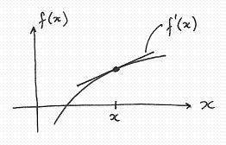
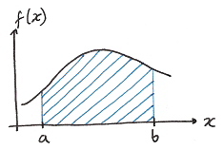
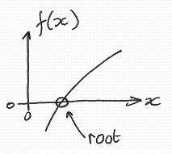
Introduction
Numerical methods apply algorithms that use numerical approximations to solve mathematical problems.
This is in contrast to applying symbolic analytical solutions,
for example Calculus.
We will look at very basic, but useful numerical algorithms for:
1.Differentiation
2. Integration
3. Root finding

Slide 3
Taylor’s Expansion
Key to the formulation of numerical techniques for differentiation, integration and root finding is Taylor’s expansion:
The value of a function at x + h is given in terms of the values of derivatives of the function at x
The general idea is to use a small number of terms in this series to approximate a solution.
In some cases we can improve on the solution by iterating the procedure ⇒ ideal task for a computer.

Slide 4
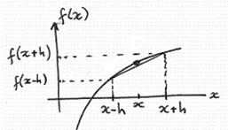

1. Numerical differentiation
Aim
Given a function f(x), we wish to calculate the derivative f’(x); that is, the gradient of the function at x.
The Central Difference Approximation,
CDA, provides an approximation to this gradient:

Slide 5
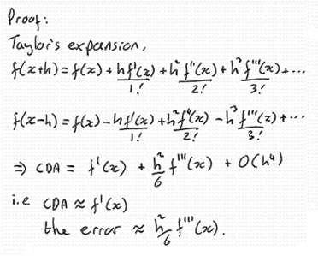
Proof
The approximation improves as the size of h reduces.
Limited precision in the computer prevents us from making h very small!

Slide 6
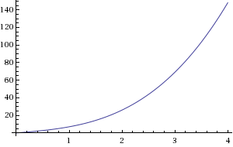
Problem
For the following function, calculate the derivative at

Slide 7

Algorithm
1. Define the function:
2. Set the parameters:
3 Calculate the CDA:
4 Output the result.
x = 2, h = 0.01

Slide 8
C++ code
// Central-Difference Approximation (CDA)
// for the derivative of a function f(x).
// Here, f(x)=2*x^3+5*x, h=0.01, x=2.0.
#include <iostream>
using namespace std;
double f(double x) { return 2*x*x*x + 5*x; }
int main() {
double x=2.0, h=0.01;
double cda = (f(x+h)-f(x-h))/(2*h);
cout << "f'(" << x << ") = " << cda << endl;
}
Output
f'(2) = 29.0002

Slide 9
Verification
The program gives us f'(2) = 29.0002
We can verify that this is what we expect:
The function here is f(x) = 2 x³ + 5 x
From calculus we can obtain f’(x) = 6 x² + 5
and so the exact solution for f’(2) is 6*2² + 5 = 29.0000
We see that the error in the CDA is 29.0002 – 29.0000 = 0.0002
From analysis of Taylor’s expansion we predict the error
in the CDA as ≈ h² f’’’(x)/6
= 0.01².12/6 = 0.0002
Our algorithm is working as predicted.
From Calculus
f(x) = 2 x³ + 5 x
f’(x) = 6 x² + 5
f’’(x) = 12 x
f’’’(x) = 12

Slide 10
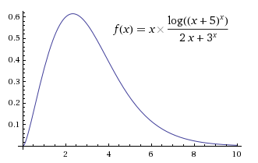
A more difficult problem
So far the CDA does not look so useful, we have only solved
a trivial problem. Let’s try a more difficult function:
Evaluate f’(4)
Analytical solution

Slide 11
Adapt the C++ code for the new calculation
// Central-Difference Approximation (CDA)
// for the derivative of a function f(x).
#include <iostream>
#include <cmath>
using namespace std;
double f(double x) {
return x*log(pow(x+5,x))/(2*x+pow(3,x));
}
int main() {
double x=4.0, h=0.01;
double cda = (f(x+h)-f(x-h))/(2*h);
cout << "f'(" << x << ") = " << cda << endl;
}
Output
f'(4) = -0.186348
The error is +0.000002

Slide 12


2. Numerical integration
Aim
We wish to perform numerically
the following integral:
This is simply the area under the curve f(x) between a and b.
For example,
How can we perform this numerically?

Slide 13
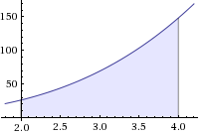
Formulating an algorithm
A first approximation can be obtained by forming a trapezoid.
Trapezoid area
= ½ (f(2)+f(4)) (4-2) = ½ (26+148) (2) = 174.
The error in the result is16%
a
b

Slide 14
An improved approximation can be obtained by forming
two trapezoids.
Trapezoid area
= ½ (f(2)+f(3)) (3-2) + ½ (f(3)+f(4)) (4-3) = 156
The error in the result is 4%
a
b

Slide 15
Four trapezoids.
Trapezoid area
= ½ (f(2.0)+f(2.5)) (2.5-2.0) + ½ (f(2.5)+f(3.0)) (3.0-2.5)
+ ½ (f(3.0)+f(3.5)) (3.5-3.0) + ½ (f(3.5)+f(4.0)) (4.0-3.5)
= 151.5
The error in the result is 1%
The error ∝ 1/n²
where n is the
number of trapezoids.
a
b

Slide 16
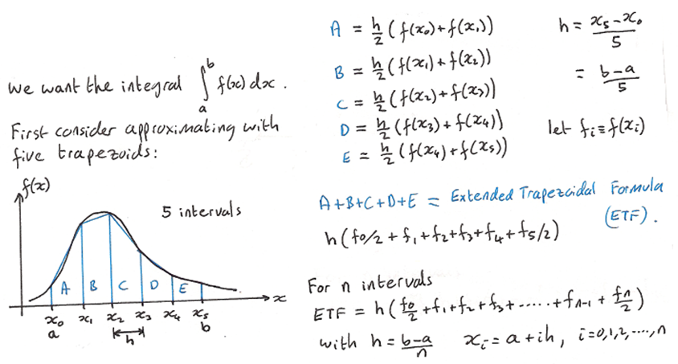
Formulating an algorithm
Generalising the procedure:

Slide 17

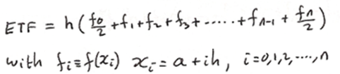
Algorithm
1. Define the function:
2. Set the limits of the integral, and the number of trapezoids:
3. Set
4. Calculate the ETF as
5. Output the result.
a = 2, b = 4, n = 100

Slide 18
C++ code
// Numerical integration via the Extended
// Trapezoidal Formula (ETF)
#include <iostream>
using namespace std;
double f(double x) { return 2*x*x*x + 5*x; }
int main() {
double a=2.0, b=4.0;
int n=100;
double h = (b-a)/n;
double etf = (f(a)+f(b))/2;
for (int i=1; i<n; i++) etf = etf + f(a+i*h);
etf = etf * h;
cout << "The integral = " << etf << endl;
}
Output
The integral = 150.002
Error = 0.002

Slide 19
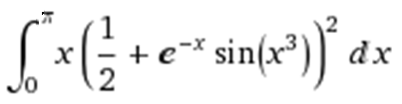
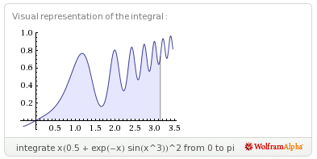

A more difficult problem

Slide 20
Adapt the previous C++ code
#include <iostream>
#include <cmath>
using namespace std;
double f(double x) {
return x * pow(0.5+exp(-x)*sin(x*x*x),2); }
int main() {
double a=0.0, b=M_PI;
int n=100;
double h = (b-a)/n;
double etf = (f(a)+f(b))/2;
for (int i=1; i<n; i++) etf = etf + f(a+i*h);
etf = etf * h;
cout << "The integral = " << etf << endl;
}
Output
The integral = 1.46937
The error is +0.00030

Slide 21
3. Root finding
Aim
We wish to find the root x₀ of
the function f(x); i.e. f(x₀) = 0.
How can we perform this numerically?
There are many ways to do this.
We will implement the Newton-Raphson method....

Slide 22
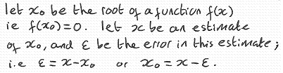
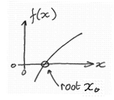

Formulating an algorithm

Slide 23
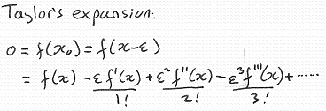
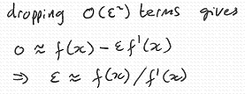
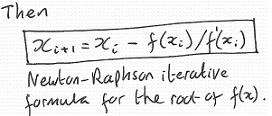
Obtaining an
error estimate:
The algorithm so far:
1. define f(x) and d(x)
2. Initialise x
3. Iterate:
e = f(x)/d(x)
x = x – e
4. Output x
But how many iterations?
d(x)

Slide 24
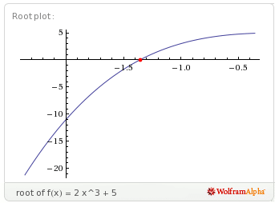

We have an estimate of the error
Use this to form a termination condition that requires
6 decimal place accuracy:
“ iterate until ε < 10⁻⁹ ”
Algorithm
1. define f(x) and d(x)
2. initialise x
3. iterate:
e = f(x)/d(x)
if ε < 10⁻⁹ terminate
x = x – e
4. Output x
Example

Slide 25

C++ code
// Newton-Raphson method for the root of f(x)
#include <iostream>
#include <iomanip>
#include <cmath>
using namespace std;
double f(double x) { return 2*x*x*x + 5; }
double d(double x) { return 6*x*x; }
int main() {
cout << setprecision(9) << fixed;
double e, x = -1.5;
while (true) {
e = f(x)/d(x);
cout << "x = " << x << endl;
if (fabs(e)<1.0e-6) break;
x = x - e;
}
}

Slide 26

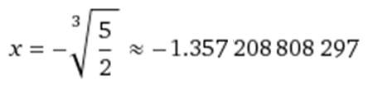
Output
x = -1.500000000
x = -1.370370370
x = -1.357334812
x = -1.357208820
The number of correct digits doubles on every iteration (rapid convergence)!
7 decimal place accuracy

Slide 27
Finally
In this lecture we have looked at Numerical Methods.
More about numerical methods can be found at:
http://en.wikipedia.org/wiki/Numerical_methods

